Slide 1

Assembly Language
Part I Data Representation and 8086 Microprocessors
Department of Computer Science, Faculty of Science, Chiang Mai University

Slide 2
Outline
Data Organization
Programming Languages
Integer Representation
Character Representation
Organization of the 8086/8088 Microprocessors
Computer Registers

Slide 3
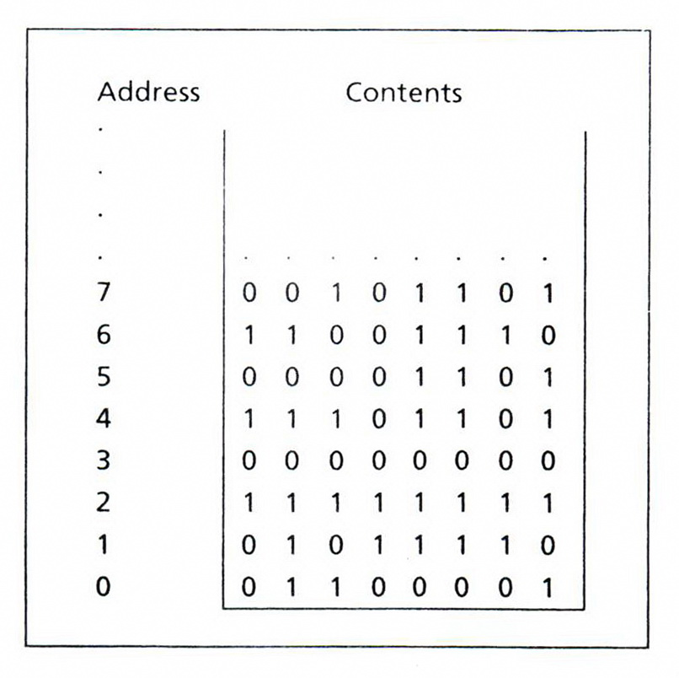
Memory Represented as Bytes

Slide 4
Bit - Byte - Word
Information processed by the computer is stored in its memory.
The memory circuits are usually organized into groups that can store eight bits of data.
A string of eight bits is called a byte.
Each memory byte is identified by a number that is called address.
The data stored in a memory byte are called its contents.

Slide 5
Bit Position
The positions are numbered from right to left, starting with 0.
In a word, the bits 0 to 7 form the low byte and the bits 8 to 15 form the high byte.
For a word stored in memory, its low byte comes from the memory byte with the lower address and its high byte is from the memory byte with the higher address.

Slide 6
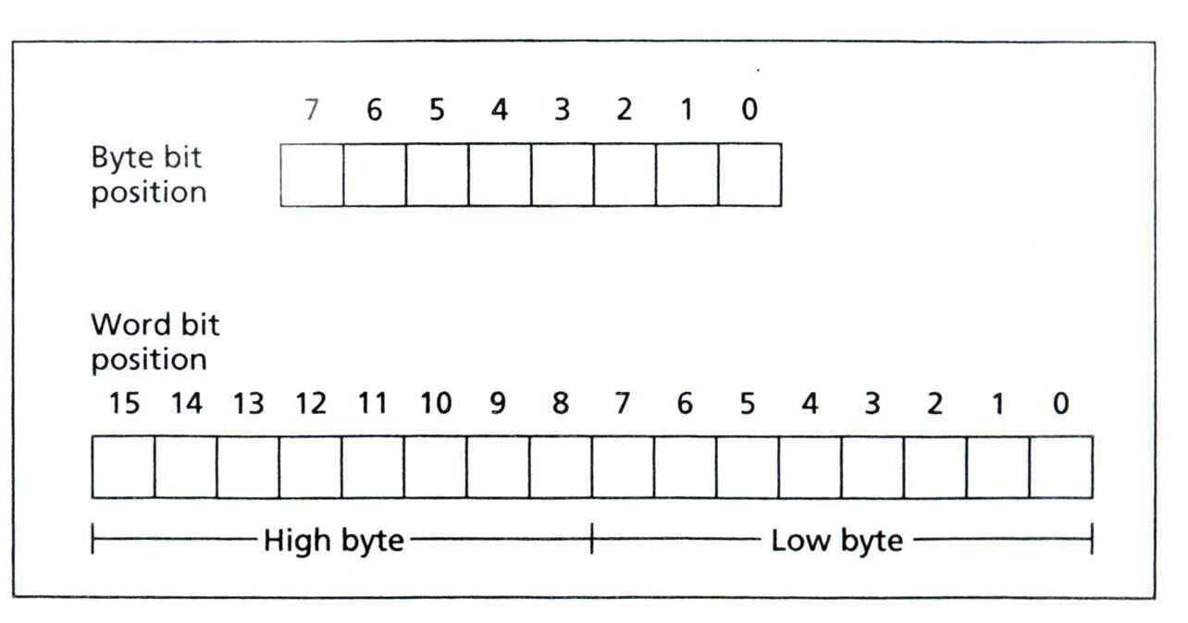
Bit Positions in a Byte and a Word

Slide 7
Machine Language
The CPU can only execute machine language instructions.
They are bit strings.
The Opcode specifies the type of operation.
The Operands are often given as memory addresses to the data to be operated on.
00000101 00000100 00000000 ; Add 4 to AX.

Slide 8
Assembly Language
A more convenient language to use
We use symbolic names to represent operations, registers, and memory locations.
Assembler
ADD AX, 4

Slide 9
Integer Representation
The Least Significant Bit (LSB) is the rightmost bit.
In a byte or word, bit 0
The Most Significant Bit (MSB) is the leftmost bit.
In a word, bit 15
In a byte, bit 7

Slide 10
Unsigned Integers
An unsigned integer represents a magnitude.
Unsigned integers are appropriate for representing quantities that can never be negative.
Addresses of memory locations
Counters
ASCII Code

Slide 11
Unsigned Integers
The largest unsigned that can be stored in a byte is 1111 1111= FFh = 255.
The biggest unsigned integer a 16-bit word can hold is 1111 1111 1111 1111 = FFFFh =65535.
Note that if the least significant bit of an integer is 1, the number is odd, and it’s even if the lsb is 0.

Slide 12
Signed Integers
A signed integer can be positive or negative.
The msb is reserved for the sign:
1 means negative.
0 means positive.
Negative integers are stored in the computer in a special way known as two’s complement.

Slide 13
Two’s Complement
The one’s complement of an integer is obtained by complementing each bit; that is, replace each 0 by a 1 and each 1 by a 0.
To get the two’s complement of an integer, just add 1 to its one’s complement.

Slide 14
Find the two’s complement of 5.
5 = 0000 0000 0000 0101
One’s com. of 5 = 1111 1111 1111 1010
Two’s com. of 5 = 1111 1111 1111 1011

Slide 15
Subtraction as Two’s Complement Addition
A subtraction can be done by bit complementation and addition.
The circuits that add and complement bits are easy to design.

Slide 16
Subtraction as Two’s Complement Addition
Ex.: Suppose AX contains 5ABCh and BX contains 21FCh. Find the difference of AX minus BX by using complementation and addition.
Solution: 5ABCh = 0101 1010 1011 1100
+ One’s com. of 21FCh = 1101 1110 0000 0011
+1
Difference = 1 0011 1000 1100 0000
= 38C0h
Note that 21FCh = 0010 0001 1111 1100

Slide 17
Subtraction as Two’s Complement Addition
A one is carried out of the most significant bit and is lost.
The answer stored, 38C0h, is correct, as may be verified by hex subtraction.

Slide 18
Unsigned Decimal Interpretation
Just do a binary-to-decimal conversion.
It’s usually easier to convert binary to hex first, and then convert hex to decimal.

Slide 19
Signed Decimal Interpretation
If the msb is 0, the number is positive, and the signed decimal is the same as the unsigned decimal.
If the msb is 1, the number is negative, so call it –N.
To find N, just take the two’s complement and then convert to decimal as before.

Slide 20
Suppose AX contains FE0Ch. Give the unsigned and signed decimal interpretations.
FE0Ch = 1111 1110 0000 1100
For the unsigned decimal interpretations
FE0Ch = 65036
For the signed decimal interpretations
FE0Ch = –N
One’s com. of FE0Ch = 0000 0001 1111 0011
Two’s com. of FE0Ch = 0000 0001 1111 0100
N = 01F4h = 500

Slide 21
ASCII Code
American Standard Code for Information Interchange Code
The ASCII Code system uses seven bits to code each character, so there are a total of 2⁷ = 128 ASCII codes.
Notice that only 95 ASCII codes, from 32 to 126, are considered to be printable.

Slide 22
Show how the character string “RG 2z” is stored in memory, starting at address 0.
Address Contents Character
0 0101 0010 R
1 0100 0111 G
2 0010 0000
3 0011 0010 2
4 0111 1010 z

Slide 23
The 8086 and 8088 Microprocessors
Intel introduced the 8086 in 1978 as its first 16-bit microprocessor.
A 16-bit processor can operate on 16 bits of data at a time.
The 8088 has an 8-bit data bus.
Because the 8086 and 8088 essentially have the same internal structure, the name “8086” applies to both 8086 and 8088.

Slide 24
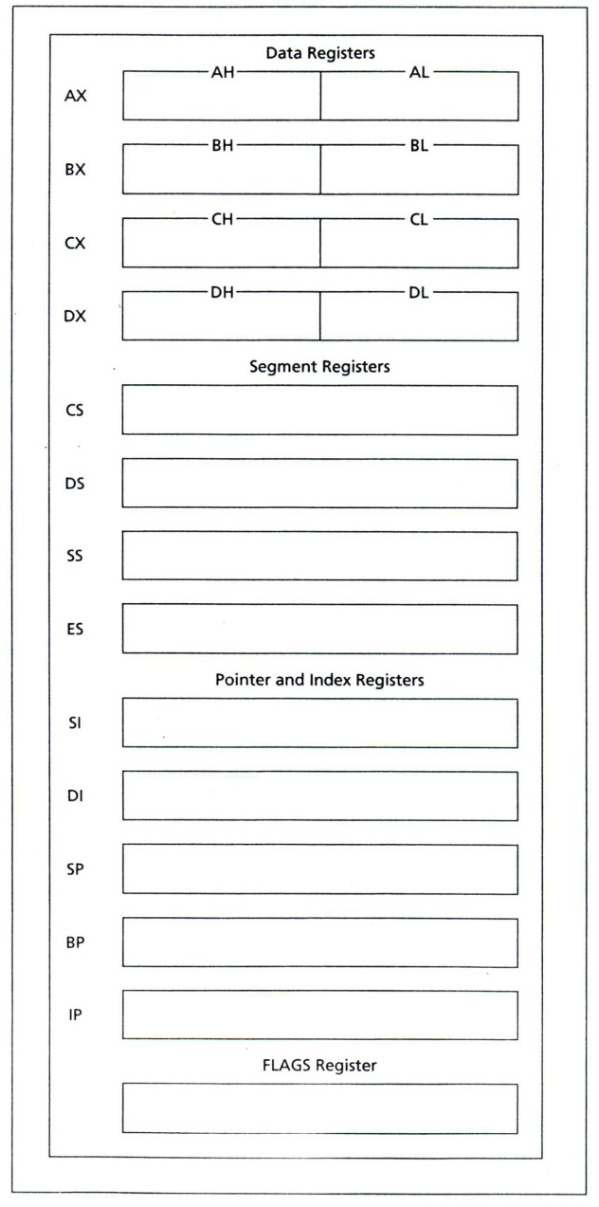
8086 Registers
AX: Accumulator Register
BX: Base Register
CX: Count Register
DX: Data Register
CS: Code Segment
DS: Data Segment
SS: Stack Segment
ES: Extra Segment
SI: Source Index
DI: Destination Index
SP: Stack Pointer
BP: Base Pointer
IP: Instruction Pointer

Slide 25
Data Registers
General-Purpose Registers
Data registers are available to programmers for general data manipulation.
Even though a processor can operate on data stored in memory, the same instruction is faster (requires fewer clock cycles) if the data are stored in registers.
The high and low bytes of data registers can be accessed separately.

Slide 26
Segment Registers
Address Registers
Segment registers store addresses of instructions and data in memory.
These values are used by a processor to access memory location.
The idea of memory segments is a direct consequence of using a 20-bit address in a 16-bit processor.

Slide 27
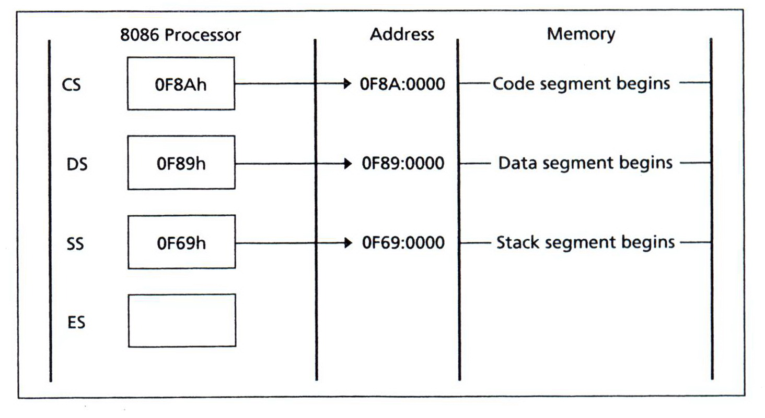
Segment Registers

Slide 28
Physical Address
8086 assigns a 20-bit physical address to its memory.
It is possible to address 2²⁰ = 1,048,576 bytes (one megabyte) of memory.

Slide 29
Physical Address
0000 0000 0000 0000 0000 00000h
0000 0000 0000 0000 0001 00001h
0000 0000 0000 0000 0010 00002h
0000 0000 0000 0000 0011 00003h
………………………………………………………………
1111 1111 1111 1111 1110 FFFFEh
1111 1111 1111 1111 1111 FFFFFh

Slide 30
Segment
A memory segment is a block of 2¹⁶ (or 64 K) consecutive memory bytes.
Each segment is identified by a segment number, starting with 0.
A segment number is 16 bits, so the highest segment number is FFFFh.

Slide 31
Offset
Within a segment, a memory location is specified by giving an offset.
An offset is the number of bytes from the beginning of the segment.
With a 64-KB segment, the offset can be given as a 16-bit number.
The first byte in a segment has offset 0.
The last offset in a segment is FFFFh.

Slide 32
Logical Address
Segment:Offset Addressing
To obtain a 20-bit physical address, the 8086 microprocessors first shifts the segment address 4 bits to the left (this is equivalent to multiplying by 10h), and then adds the offset.
Physical Address = Segment × 10h + Offset
A4FB:4872 = A4FB0h + 4872h = A9822h

Slide 33
Pointer and Index Registers
SP, BP, SI, and DI normally point to (contain the offset addresses of) memory locations.
Unlike segment registers, pointer and index registers can be used in arithmetic and other operations.

Slide 34
IP (Instruction Pointer)
To access instructions, 8086 uses CS and IP.
CS contains the segment number of the next instruction, and IP contains the offset.
IP is updated each time an instruction is executed so that it will point to the next instruction.
Unlike other registers, IP cannot be directly manipulated by an instruction; that is, an instruction may not contain IP as its operand.

Slide 35
FLAGS Register
The purpose of FLAGS is to indicate the status of a microprocessor
When a subtraction operation results in a 0, ZF (zero flag) is set to 1 (true).

Slide 36
Reference
Ytha Yu and Charles Marut, Assembly Language Programming and Organization of the IBM PC. New York: McGraw-Hill, 1992.

